Slide 1


Nutan Maharashtra Vidya Prasarak Mandal’s NUTAN COLLEGE OF ENGINEERING AND RESEARCH Under Administrative Support of Pimpri Chinchwad Education Trust ISO 21001:2018 EOMS Certified
Project Phase-2 Presentation
Presentation on
“ Hybrid Deep Learning for Cyclone Intensity Estimation using Multi-Source Satellite Data ”
By
Aman Maner (26)
Pratik Gade (28)
Arpita Phalke (43)
Kirti Rachkar (47)
Under the guidance of
Prof. Priyanka Vyas
Department of Computer Science Engineering - Artificial Intelligence
Saturday, 21 June 2025

Slide 2
Nutan Maharashtra Vidya Prasarak Mandal’s NUTAN COLLEGE OF ENGINEERING AND RESEARCH Under Administrative Support of Pimpri Chinchwad Education Trust ISO 21001:2018 EOMS Certified
Project Phase-2 Presentation
Introduction :
Cyclones are destructive natural disasters, making early and accurate intensity estimation vital for disaster management. Estimating cyclone intensity, particularly in its early stages, is difficult due to unclear storm centers, delaying timely responses. This project uses deep learning, specifically Convolutional Neural Networks (CNNs) and transfer learning, to estimate cyclone intensity without pinpointing the storm’s center. By leveraging multi-source satellite data, the model aims to predict cyclone strength efficiently. A web application will also be developed for real-time cyclone monitoring, enhancing disaster preparedness and response.
Problem Statement:
Cyclones in the Indian Ocean pose significant threats to coastal communities, yet accurately predicting their intensity remains a challenge. Existing forecasting systems often struggle with providing real-time updates, handling vast amounts of satellite imagery, and making their predictions understandable for meteorologists. Moreover, models trained on global cyclone data may not be fully optimized for Indian Ocean-specific conditions. Additionally, real-time prediction systems require robust data pipelines for continuous updates, which existing models lack. This limits their effectiveness in disaster preparedness and timely warnings, risking lives and property.

Slide 3
Nutan Maharashtra Vidya Prasarak Mandal’s NUTAN COLLEGE OF ENGINEERING AND RESEARCH Under Administrative Support of Pimpri Chinchwad Education Trust ISO 21001:2018 EOMS Certified
Project Phase-2 Presentation
Problem Solution :
This project proposes an AI-driven solution for cyclone intensity estimation by utilizing multi-source satellite data and hybrid deep learning models. A combination of Convolutional Neural Networks (CNNs) and transformer will be employed to accurately predict cyclone intensity in real-time. Transfer learning will be used to fine-tune global models for Indian Ocean-specific conditions, improving prediction accuracy. A dynamic real-time system will continuously update cyclone intensity using live satellite data, and a web interface will provide intuitive, interpretable visualizations, helping meteorologists and disaster management teams make faster, informed decisions.

Slide 4
Nutan Maharashtra Vidya Prasarak Mandal’s NUTAN COLLEGE OF ENGINEERING AND RESEARCH Under Administrative Support of Pimpri Chinchwad Education Trust ISO 21001:2018 EOMS Certified
Project Phase-2 Presentation
Objectives :
To collect and preprocess multi-source satellite imagery and atmospheric data for cyclones across the Indian Ocean.
To implement hybrid deep learning architectures combining Convolutional Neural Networks (CNNs) with transformer-based models for cyclone intensity estimation.
To evaluate and validate the performance of the developed deep learning model for cyclone intensity prediction using metrics such as root mean squared error (RMSE)
To explore transfer learning techniques by fine-tuning pre-trained global cyclone models for Indian Ocean-specific cyclone intensity estimation.
To develop a dynamic real-time deep learning model that updates cyclone intensity estimates continuously using real-time satellite imagery.
To develop a web interface and interpretable AI models that provide explanations for their predictions of cyclone intensity, enhancing trust and usability for meteorologists.

Slide 5
Nutan Maharashtra Vidya Prasarak Mandal’s NUTAN COLLEGE OF ENGINEERING AND RESEARCH Under Administrative Support of Pimpri Chinchwad Education Trust ISO 21001:2018 EOMS Certified
Project Phase-2 Presentation
Literature Survey :
SR.NO | TITLE | METHODOLOGY | DATASET | LIMITATIONS | GAP FINDING
1 | Cyclone Intensity Estimation on INSAT 3D IR Imagery Using Deep Learning | CNN-based classification using TensorFlow/Keras. | INSAT-3D IR (2012–2021). | Limited resolution and image noise. | Lacks temporal modelling (e.g., LSTM).
2 | Deep Learning Based Cyclone Intensity Estimation using INSAT-3D IR Imagery | CNN trained on IR images in 5 kt intervals. | INSAT-3D IR imagery with intensity labels. | No path prediction or temporal modelling. | Omits sequential modeling for dynamic changes.
3 | A neural network framework for fine-grained tropical cyclone intensity prediction | Spatio-temporal model using transformer and feature aggregation. | Multi-source atmospheric, oceanic, precipitation data. | Poor fusion in prior methods, no fine-grained forecasts. | Enhances fine-scale prediction and data integration.
4 | Transformer-based tropical cyclone track and intensity forecastin | Transformer with multi-head self-attention. | CMA data (1980–2021), 1257 TCs. | Assumes uniform data quality; sparse data. | Improves long-term dependency modeling.
5 | Short-term prediction of the intensity and track of tropical cyclone via ConvLSTM model | ConvLSTM captures time and feature dependencies. | CMA, CIMSS, NOAA, ECMWF (1980–2021). | Cross-source data inconsistency. | Solves short-term and parameter correlation issues.

Slide 6
Nutan Maharashtra Vidya Prasarak Mandal’s NUTAN COLLEGE OF ENGINEERING AND RESEARCH Under Administrative Support of Pimpri Chinchwad Education Trust ISO 21001:2018 EOMS Certified
Project Phase-2 Presentation
6 | Tropical Cyclone Intensity and Track Prediction in the Bay of Bengal Using LSTM-CSO Method | LSTM optimized by Cat Swarm Optimization. | IBTrACS (2003–2019) with TC parameters. | Limited region and high computation cost. | Boosts speed and accuracy over traditional models.
7 | Tropical cyclone trajectory based on satellite remote sensing prediction and time attention mechanism ConvLSTM model | ConvLSTM with time attention mechanism. | NCEP/NCAR, HURSAT-B1 (1949–2022). | Needs preprocessing; limited data. | Improves 3D and long-term forecasting.
8 | Cyclone Intensity Estimation Using INSAT-3D IR Imagery | Combines image processing, CNN, RNN, and meteorological models. | INSAT-3D IR imagery. | Accuracy limited by satellite quality. | Aims for real-time high-precision estimates.
9 | Tropical Cyclone Intensity Prediction Using DeepLearning Techniques- A Survey | Review of CNNs and Transformers for TC intensity. | Satellite imagery (clouds, temp, structure). | Needs large, balanced data; low interpretability. | Calls for interpretable, sequence-aware models.

Slide 7
Nutan Maharashtra Vidya Prasarak Mandal’s NUTAN COLLEGE OF ENGINEERING AND RESEARCH Under Administrative Support of Pimpri Chinchwad Education Trust ISO 21001:2018 EOMS Certified
Project Phase-2 Presentation
Dataset :
Sr. No. | Name | Interval | Description | Region | Source
1 | NSAT3D Infrared & Raw Cyclone Imagery | 2012-2021 | Infrared and raw cyclone imagery labeled with intensity in knots, sourced from MOSDAC, timestamped to intensity-time graphs. | Indian Ocean | Kaggle
2 | INSAT3D Infrared & Raw Cyclone Imagery | 2012-2022 | Infrared and raw imagery dataset for cyclone tracking and intensity analysis. | Indian Ocean | MOSDAC server
3 | The Imperial College Storm Model (IRIS) Dataset | 1980-2021 | Synthetic dataset with modeled 10,000-year outputs, reflecting 42 years of observed tropical cyclone climate patterns. | U.S. | IBTrACS, WMO data
4 | NOAA-Himawari-Dataset | 2014-2021 | Himawari-8/9 satellite data for constant weather system and typhoon observation over East Asia and the Pacific regions. | East Asia, West & Central Pacific Region | Japan Meteorological Agency (JMA)
5 | Geo-KOMPSAT-2A (GK2A) Satellite Data | 2019-2023 | High-resolution real-time weather monitoring and disaster data from the GK2A geostationary satellite. | Western North Pacific | Korea Meteorological Administration (KMA)
6 | Communication, Ocean, and Meteorological Satellite (COMS) Data | 2011–2019 | Multi-purpose geostationary satellite data for meteorology, oceanography, and communication. | Asia-Pacific, Korean Peninsula, Indian Ocean | Korea Meteorological Administration (KMA)

Slide 8
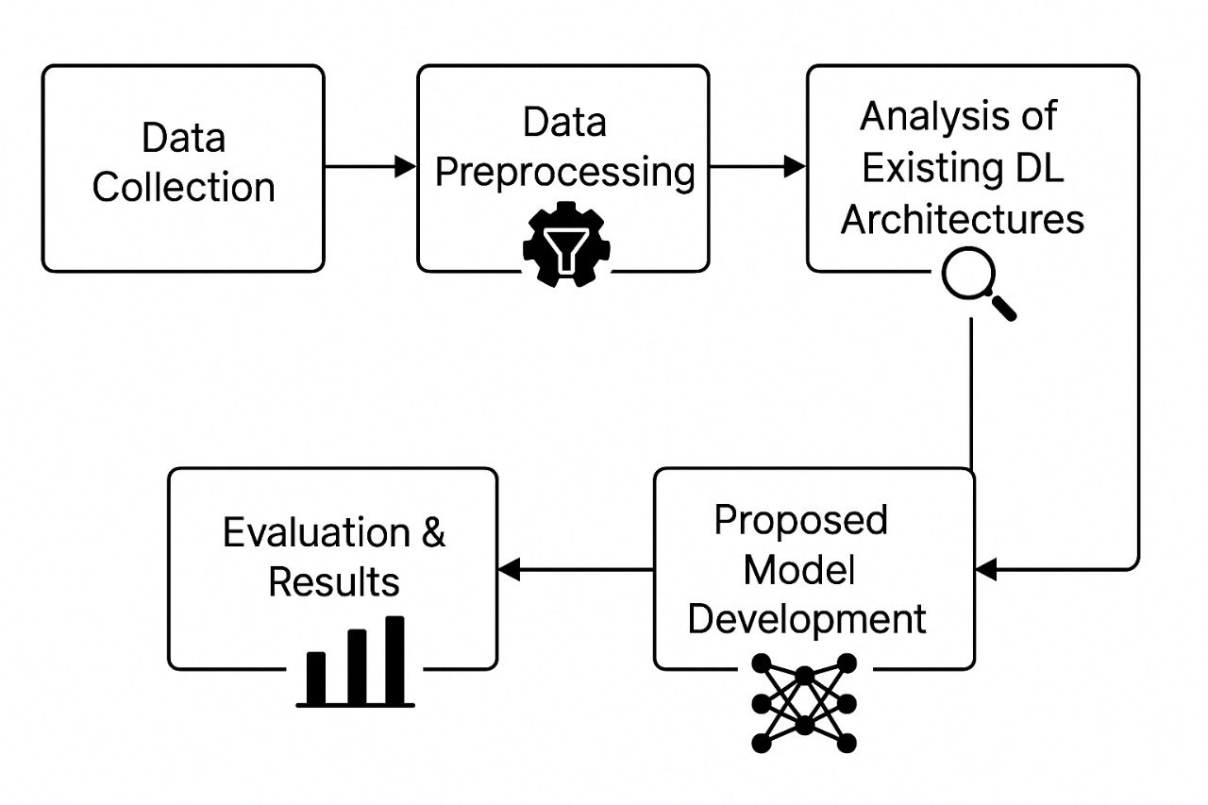
Nutan Maharashtra Vidya Prasarak Mandal’s NUTAN COLLEGE OF ENGINEERING AND RESEARCH Under Administrative Support of Pimpri Chinchwad Education Trust ISO 21001:2018 EOMS Certified
Project Phase-2 Presentation
System Architecture :
Fig .1: End-to-End System Architecture for Cyclone Intensity Estimation

Slide 9
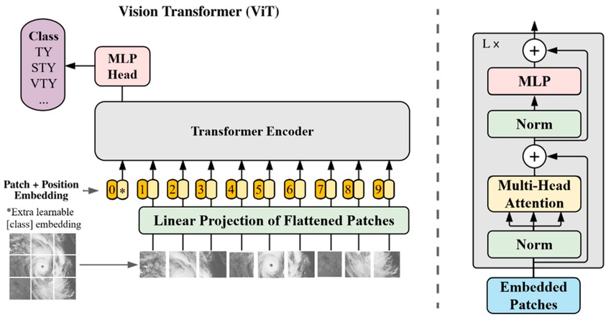
Nutan Maharashtra Vidya Prasarak Mandal’s NUTAN COLLEGE OF ENGINEERING AND RESEARCH Under Administrative Support of Pimpri Chinchwad Education Trust ISO 21001:2018 EOMS Certified
Project Phase-2 Presentation
Methodology:
Fig 2: ViT Model Architecture
Input: The system begins by taking a satellite infrared image of a tropical cyclone from the INSAT-3D dataset as input. These images capture the structure and intensity of cyclones in the Indian Ocean region.
Preprocessing: The input image is resized to a standard dimension of 224×224 pixels and normalized to a [0, 1] scale. This step ensures consistency and prepares the image for feature extraction.
Parallel Feature Extraction: The core strength of the system lies in parallel feature extraction using two complementary branches:

Slide 10
Nutan Maharashtra Vidya Prasarak Mandal’s NUTAN COLLEGE OF ENGINEERING AND RESEARCH Under Administrative Support of Pimpri Chinchwad Education Trust ISO 21001:2018 EOMS Certified
Project Phase-2 Presentation
A. Vision Transformer (ViT) Branch:
This branch utilizes a pre-trained ViT-base model (from HuggingFace). It extracts deep, high-dimensional visual features (768-d) from the image. Principal Component Analysis (PCA) is then applied to reduce dimensionality while retaining important variance. The reduced features are passed through dense layers, dropout, and batch normalization for regularization and improved learning.
B. Handcrafted Features Branch: In this branch, seven domain-specific features are computed from the image. These include:
Cloud Anisotropy Index (CAI)
Cloud Top Temperature Variance (CCTV)
Optical flow magnitude
Mean intensity, standard deviation, maximum intensity
Symmetry score (based on flipped image) These features are passed through a smaller dense network to enhance their representation.
Feature Fusion:
The outputs from both branches are concatenated and passed through dense layers with residual connections to fuse the spatial and domain-specific information. This fusion helps the model capture both visual and physical cyclone characteristics effectively.
Output: Finally, the fused features are passed through a dense layer with one neuron to predict the cyclone intensity.
This hybrid framework enhances prediction performance by combining the power of deep visual features and expert-driven handcrafted features

Slide 11
Nutan Maharashtra Vidya Prasarak Mandal’s NUTAN COLLEGE OF ENGINEERING AND RESEARCH Under Administrative Support of Pimpri Chinchwad Education Trust ISO 21001:2018 EOMS Certified
Project Phase-2 Presentation
Experimental Results :
Sr.No. | Algorithm | RMSE | MSE | MAE | LOSS
1] | Alex net | 22.93 | 525.14 | 28.73 | 17.21
2] | DenseNet | 31 | 961.00 | 38.84 | 26.82
3] | InceptionV3 | 61 | 3721.00 | 76.44 | 58
4] | Mobilenet | 61.96 | 3840.24 | 77.61 | 57.94
5] | Resnet50 | 58.66 | 3440.66 | 77.55 | 50.61
6] | Vgg | 19.34 | 374.00 | 24.23 | 14.87

Slide 12
Nutan Maharashtra Vidya Prasarak Mandal’s NUTAN COLLEGE OF ENGINEERING AND RESEARCH Under Administrative Support of Pimpri Chinchwad Education Trust ISO 21001:2018 EOMS Certified
Project Phase-2 Presentation
Fig 3: Comparison of Various Deep Learning Models on Satellite Dataset

Slide 13
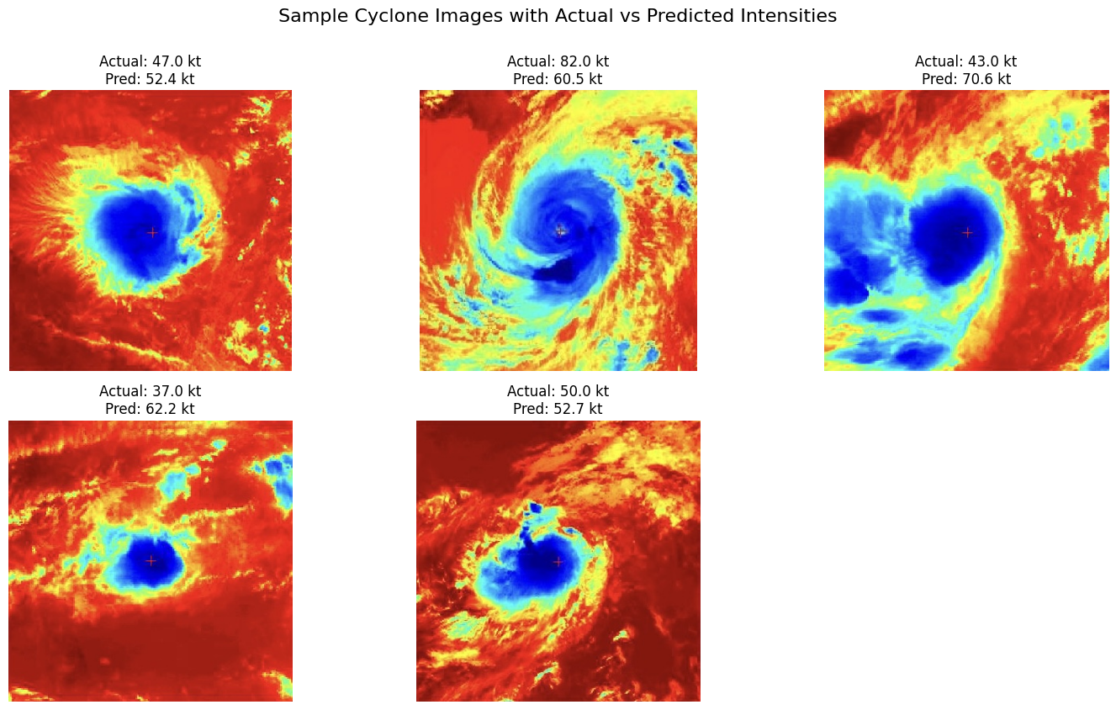
Nutan Maharashtra Vidya Prasarak Mandal’s NUTAN COLLEGE OF ENGINEERING AND RESEARCH Under Administrative Support of Pimpri Chinchwad Education Trust ISO 21001:2018 EOMS Certified
Project Phase-2 Presentation
Fig.4 :Sample Cyclone Images with Actual vs Predicted Intensities

Slide 14
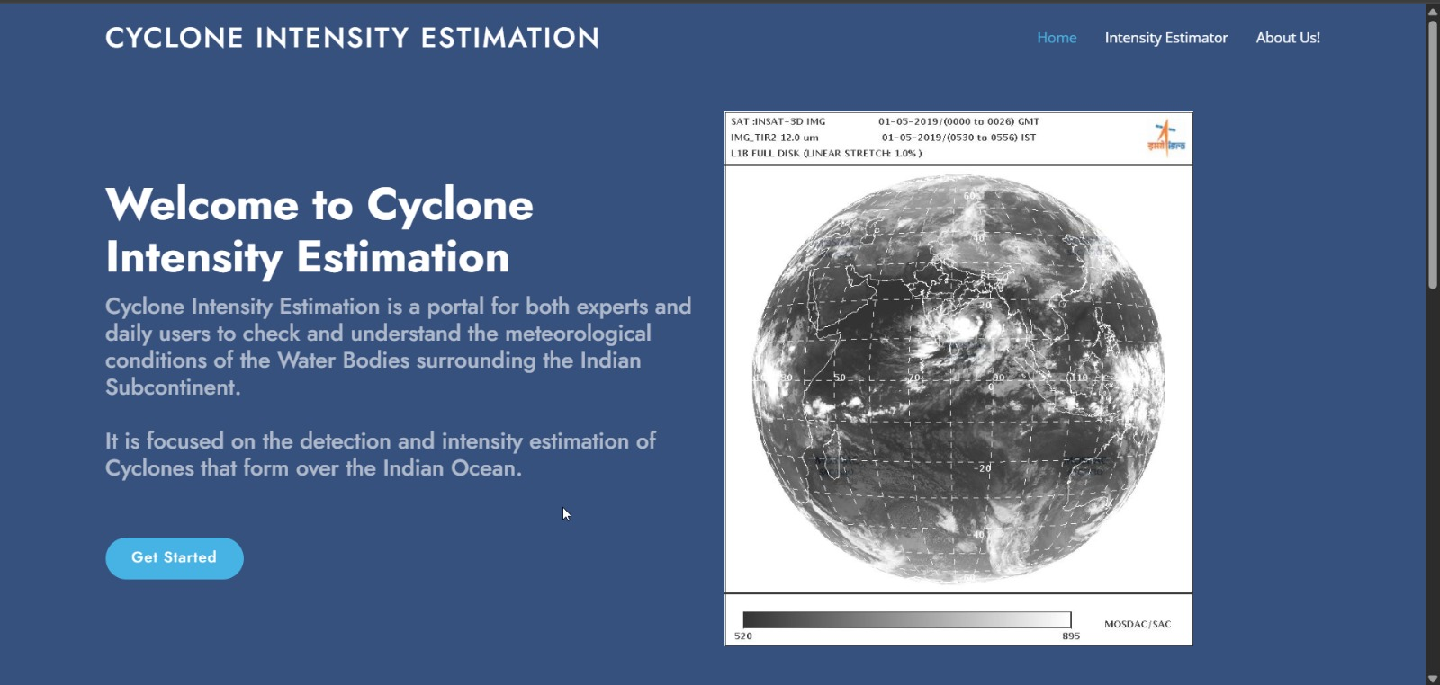
Nutan Maharashtra Vidya Prasarak Mandal’s NUTAN COLLEGE OF ENGINEERING AND RESEARCH Under Administrative Support of Pimpri Chinchwad Education Trust ISO 21001:2018 EOMS Certified
Project Phase-2 Presentation
Web application :
Fig.5: Main web interface

Slide 15
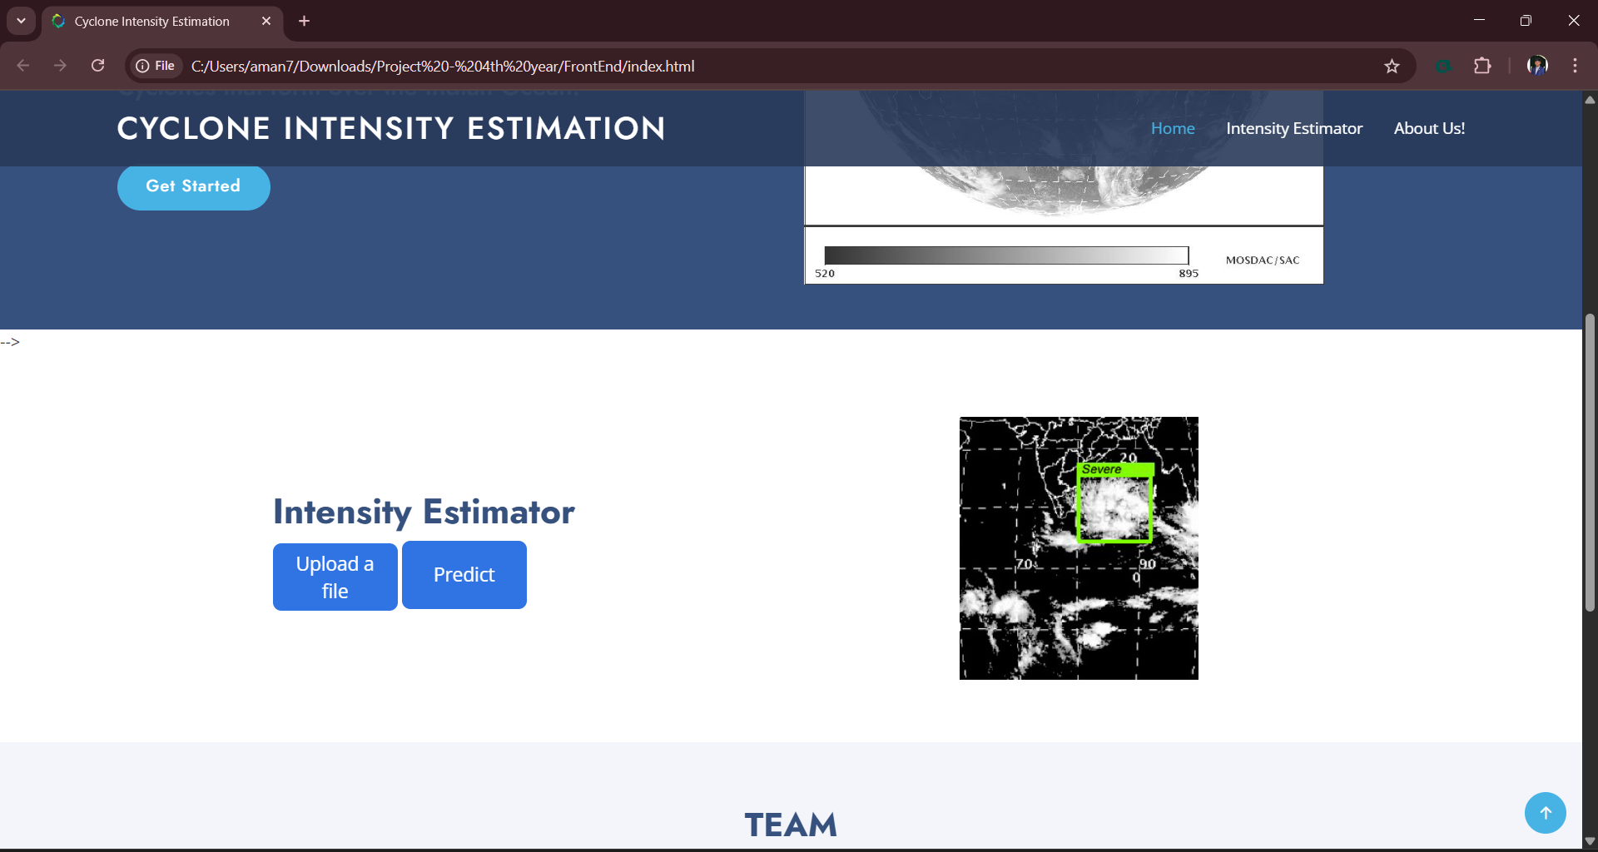
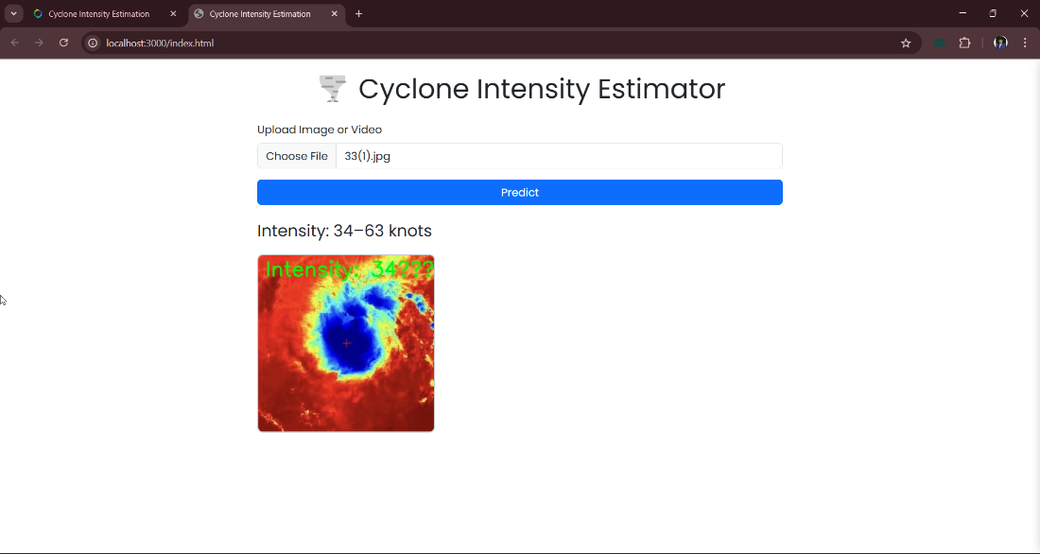
Nutan Maharashtra Vidya Prasarak Mandal’s NUTAN COLLEGE OF ENGINEERING AND RESEARCH Under Administrative Support of Pimpri Chinchwad Education Trust ISO 21001:2018 EOMS Certified
Project Phase-2 Presentation
A user-friendly web interface was developed to visualize real-time cyclone intensity predictions.
Built using HTML, CSS, and JavaScript for a responsive frontend.
Integrated with a FastAPI backend for handling prediction requests.
Users can upload satellite images and view intensity estimates instantly.
The system is currently deployed on localhost for testing and demonstration.
Fig.6 : Specified web page for Cylone Intensity Estimation

Slide 16
Nutan Maharashtra Vidya Prasarak Mandal’s NUTAN COLLEGE OF ENGINEERING AND RESEARCH Under Administrative Support of Pimpri Chinchwad Education Trust ISO 21001:2018 EOMS Certified
Project Phase-2 Presentation
Conclusion :
The developed cyclone intensity prediction model effectively combines Vision Transformer (ViT) for feature extraction and ConvLSTM for temporal analysis, ensuring accurate and reliable results. By leveraging Raw Cyclone Imagery , the model enhances real-time monitoring capabilities, which are crucial for early warning systems. The integration of key features such as optical flow, Cloud Asymmetry Index (CAI), and Cold Cloud Top Variation (CCTV) further improves the model's performance. The predicted intensity values, measured in knots, closely align with real-world observations, highlighting the model’s accuracy and effectiveness. This solution holds significant potential for meteorological departments, disaster management authorities, and researchers, offering a robust tool to mitigate cyclone risks. Future enhancements may focus on incorporating additional weather data sources, improving model resilience, and strengthening real-time prediction capabilities, ultimately contributing to better preparedness and disaster response strategies.

Slide 17
Nutan Maharashtra Vidya Prasarak Mandal’s NUTAN COLLEGE OF ENGINEERING AND RESEARCH Under Administrative Support of Pimpri Chinchwad Education Trust ISO 21001:2018 EOMS Certified
Project Phase-2 Presentation
References
[1] Manil Maskey,”Deepti: Deep Learning-based Tropical Cyclone In- tensity Estimation System,” JOURNAL OF SELECTED TOPICS IN APPLIED EARTH OBSERVATIONS AND REMOTE SENSING, 2024.
[2] Narendra Babu Alur, Supraja K.S.V,Praneetha A,Manoj G.,Kota Lokesh G.,Sivarama Sreekari T, Brahmanandam P. S., ”A DEEP LEARNING MODEL FOR EFFECTIVE CYCLONE INTENSITY ESTIMATION,” Journal of Engineering, Management and Information Technology, Vols. Vol. 02, No. 03 (2024) 161-160, doi:10.61552/JEMIT.2024.03.007 - http://jemit.aspur.rs, 2024.
[3] D. Yella Krishna, T. Praveen,Ch. Sathvika ,Ch. NVD Navya, ”Cyclone Intensity Estimation Using Deep Learning,” J. Electrical Systems, 2024.
[4] Santoshi Borapareddy, Susrutha Morishetty, Charitha Boda and K.Swathi,, ”Storm-Net: Advancing Cyclone Intensity Forecasting with Deep Learning on INSAT 3D IR Imagery,” Grenze International Journal of Engineering and Technology, 2024.
[5] Harshal Namdeorao Dharpure, Tejal Sudhakarrao Mohod, Radhika Vinod Malani,Janhavi Chandak, Atharva Shekhar Belge, Preet Ravin Ambadkar, Prof Ankita Pande, ”Deep Learning-Based Cyclone Inten- sity Estimation Using INSAT-3D IR Imagery: A Comparative Study,” International Journal of Research Publication and Reviews,, Vols. Vol 4, no 4, pp 4359-4365, 2023.
[6] Abhijna K C, B G Shreyas, Bhargavi, Dhanush Gowda S, Dr. Madhu- mala R B, ”Cyclone Intensity Estimation Using INSAT-3D IR Imagery and deep learning,” IJARIIE, Vols. Vol-9 Issue-1, 2023.

Slide 18
Nutan Maharashtra Vidya Prasarak Mandal’s NUTAN COLLEGE OF ENGINEERING AND RESEARCH Under Administrative Support of Pimpri Chinchwad Education Trust ISO 21001:2018 EOMS Certified
Project Phase-2 Presentation
[7] Matyas, Dasol Kim Corene J.,”Classification of tropical cyclone rain patterns using convolutional autoencoder,” Scientific Reports, Vols. https://doi.org/10.1038/s41598-023-50994-5, 2024.
[8] Assistant Professor Kavitha, Abhineet Raj, Tanmay Tiwari, Ayush Madurwar, ”A Deep Learning Structure for Forecasting Cyclone Inten- sity,” International Journal of Scientific Research Engineering Trends, vol. Volume 10, 2024.
[9] Samhita Kothandaraman, Shreyash Salunke , Vedant Bhatkar , Jagruti Jadhav, ”Deep Learning Based Cyclone Intensity Estimation,” 2023.
[10] Jinkai Tan, Qidong Yang , Junjun Hu , Qiqiao Huang and Sheng Chen, ”Tropical Cyclone Intensity Estimation Using Himawari-8 Satellite Cloud Products and Deep Learning,” Remote Sens, 2022.
[11] JING-YI ZHUO, AND ZHE-MIN TANa,, ”Physics-Augmented Deep Learning to Improve Tropical Cyclone Intensity and Size Estimation from Satellite Imagery,” 2021.
[12] EMANUEL, KERRY,”A Statistical Analysis of Tropical Cyclone In- tensity,” American Meteorological Society, 2000
[13] James B. Elsner, James P. Kossin Thomas H. Jagger,”The increasing intensity of the strongest tropical cyclones,” 2008.
[14] ULIE L. DEMUTH,” Improvement of Advanced Microwave Sound- ing Unit Tropical Cyclone Intensity and Size Estimation Algorithms,” American Meteorological Society, 2006.

Slide 19
Nutan Maharashtra Vidya Prasarak Mandal’s NUTAN COLLEGE OF ENGINEERING AND RESEARCH Under Administrative Support of Pimpri Chinchwad Education Trust ISO 21001:2018 EOMS Certified
Project Phase-2 Presentation
[15] Kieran T. Bhatia,”Recent increases in tropical cyclone intensificationrates,” NATURE COMMUNICATIONS.
[16] JOHN P CANGIALOSI, ERIC BLAKE,MARK DEMARIA,ANDREW PENNY,ANDREW LATTO, ”Recent Progress in Tropical Cyclone Intensity Forecasting at the National,” 2020.
[17] T. L. O. A. C. S. VELDEN, ” The Advanced Dvorak Technique: Contin- ued Development of an Objective Scheme to Estimate Tropical Cyclone Intensity Using Geostationary Infrared Satellite Imagery,” OLANDER AND VELDEN, 2007.
[18] MIGUEL F, PIN EROS, ELIZABETH, A RITCHIE, J SCOTT TYO, ”Estimating Tropical Cyclone Intensity from Infrared Image Data,” WEATHER AND FORECASTING, 2010.
[19] KIMBERLY J MUELLER, MARK DEMARIA, JOHN KNAFF,JAMES P KOSSIN, ”Objective Estimation of Tropical Cyclone Wind Structure from Infrared Satellite Data,” WEATHER AND FORECASTING, 2005.
[20] Yong Zhao, Chaofang Zhao , Ruyao Sun and Zhixiong Wang, ”AMulti- ple Linear Regression Model for Tropical Cyclone Intensity Estimation from Satellite Infrared Images,” 2016.

Slide 20
Nutan Maharashtra Vidya Prasarak Mandal’s NUTAN COLLEGE OF ENGINEERING AND RESEARCH Under Administrative Support of Pimpri Chinchwad Education Trust ISO 21001:2018 EOMS Certified
Project Phase-2 Presentation
THANK YOU!

